Slide 1
PubMed.MineR
Yashwant rana

Slide 2
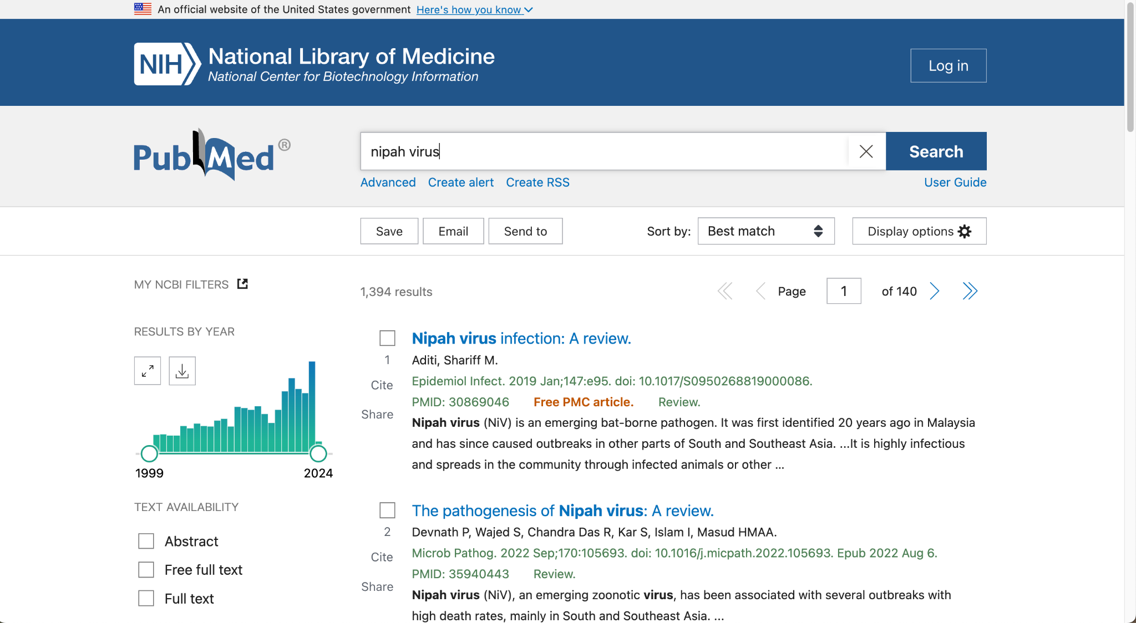

Slide 3
Reference
https://pubmed.ncbi.nlm.nih.gov/26564970/
https://cran.r-project.org/web/packages/pubmed.mineR/index.html
https://www.ias.ac.in/article/fulltext/jbsc/040/04/0671-0682
https://rdrr.io/cran/pubmed.mineR/
https://github.com/cran/pubmed.mineR/blob/master/DESCRIPTION

Slide 4
PubMed Packages
https://pubmed.ncbi.nlm.nih.gov/download/
https://www.youtube.com/watch?v=QX5aIzG8SQk
https://cran.r-project.org/web/packages/easyPubMed/vignettes/getting_started_with_easyPubMed.html
https://cran.r-project.org/web/packages/easyPubMed/index.html
https://amunategui.github.io/pubmed-query/

Slide 5
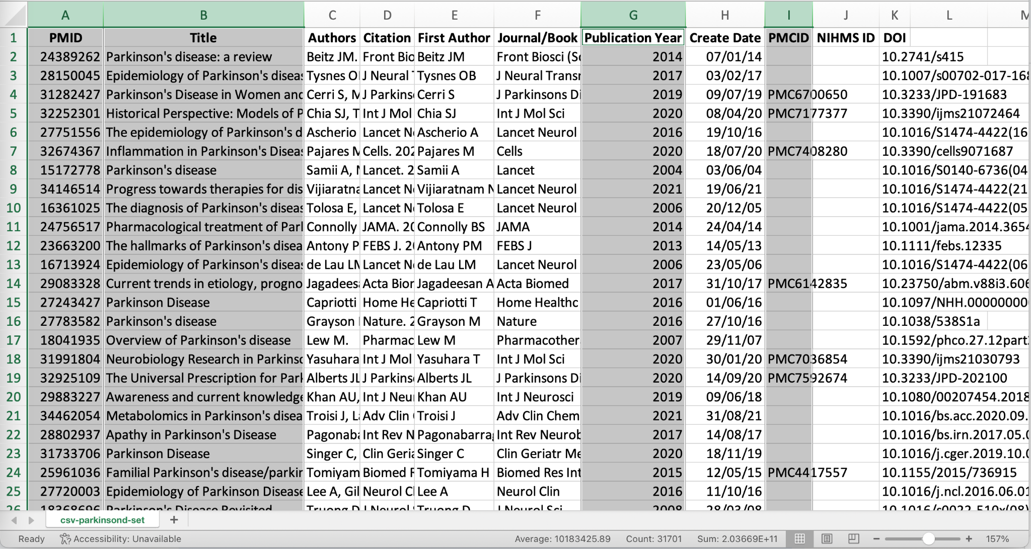
Abstracts

Slide 6
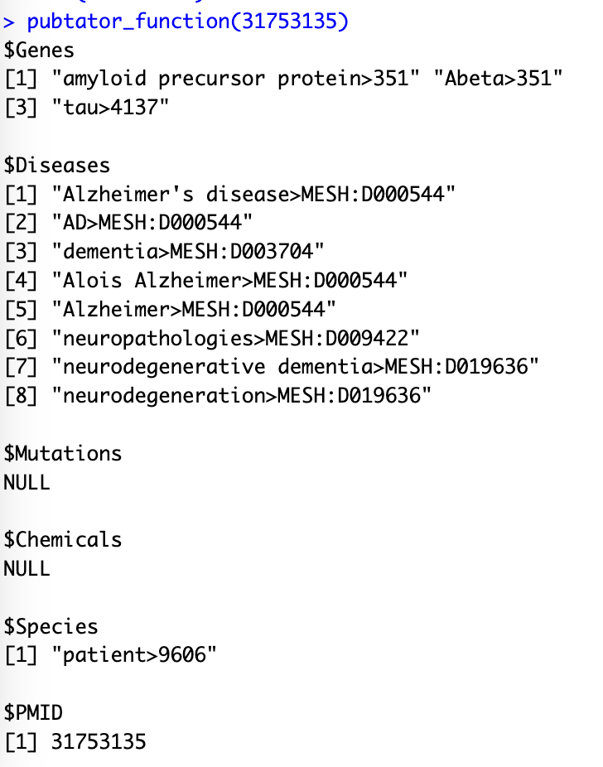
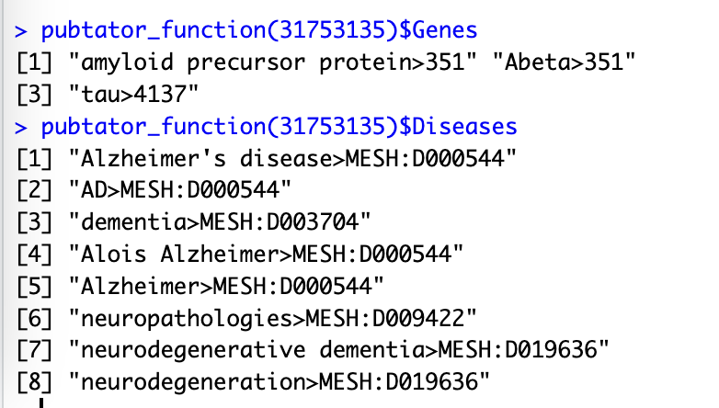
pubtator_function()

Slide 7
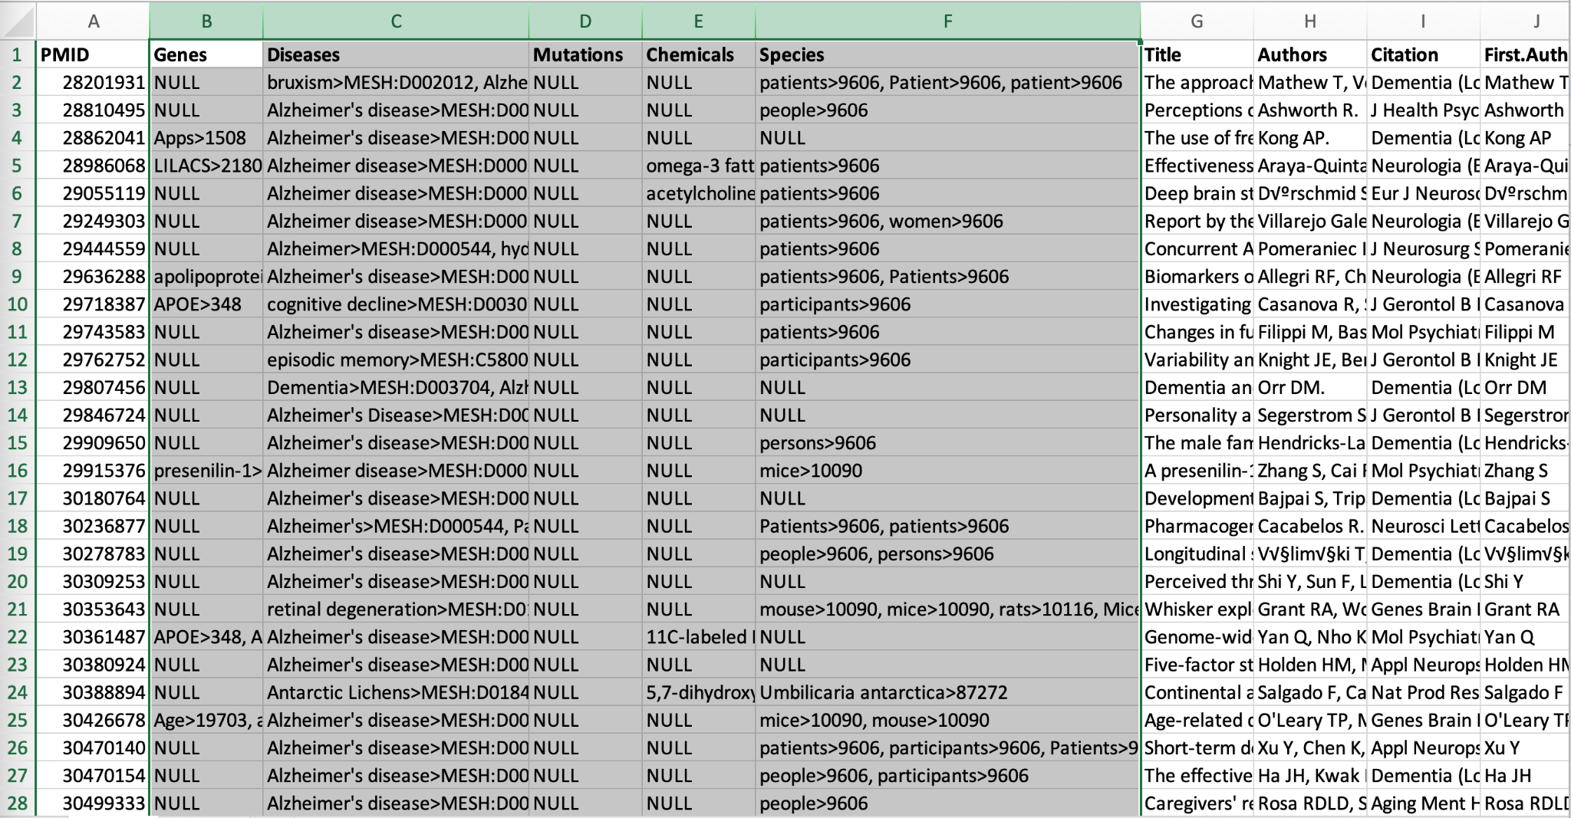

Slide 8
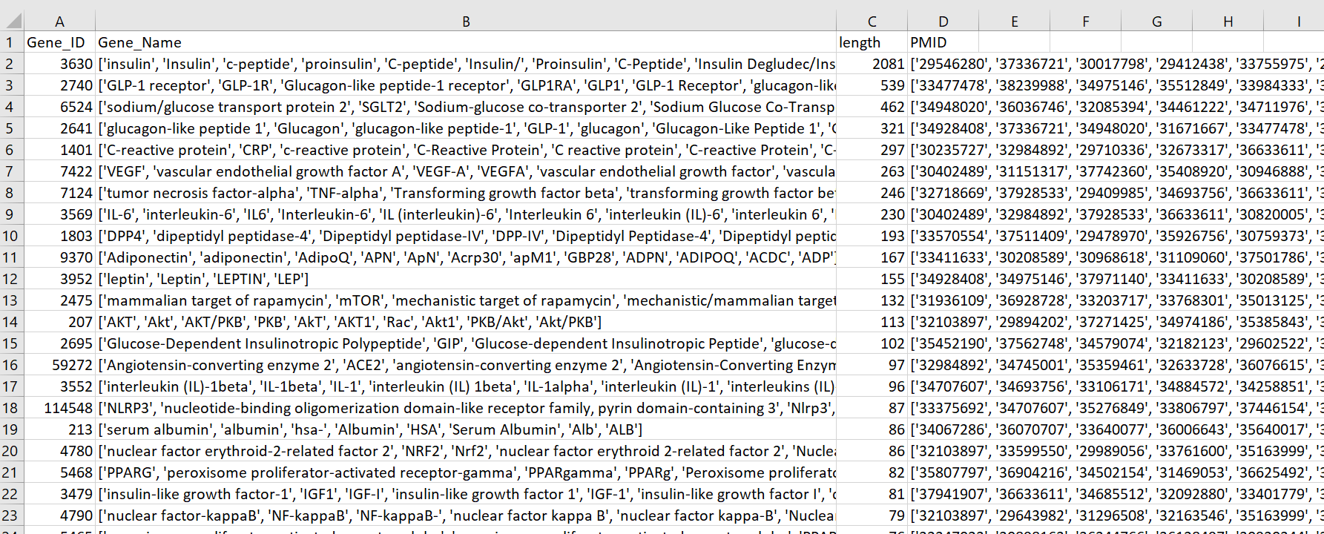
Make this for all the 5 groups

Slide 9
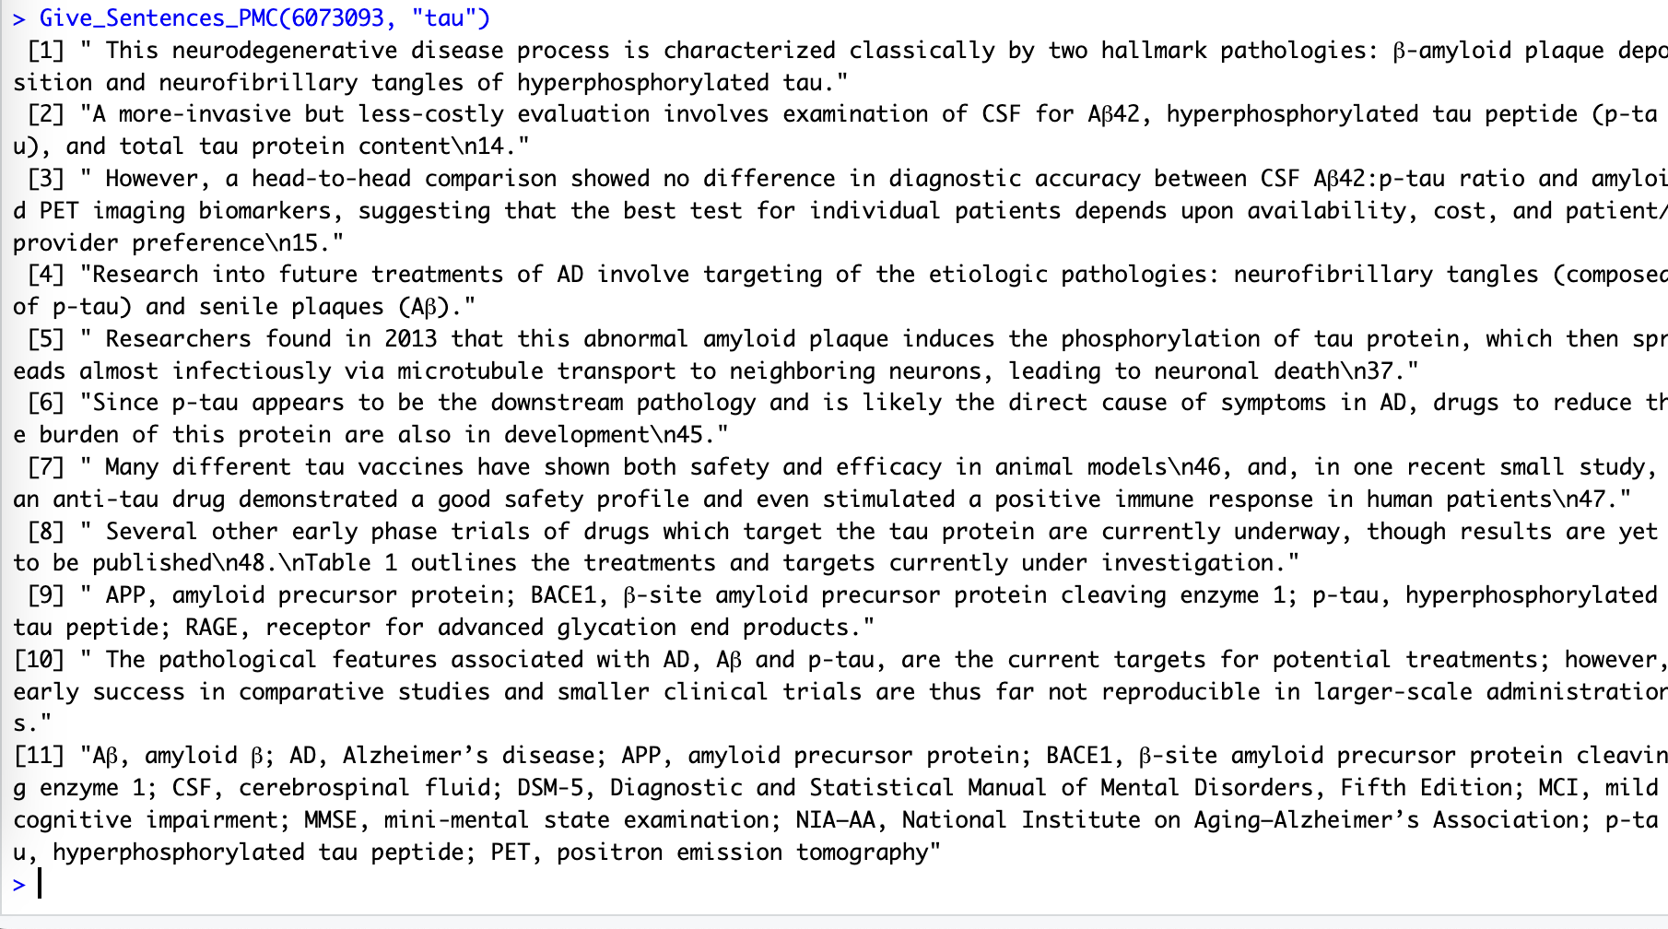
Give_Sentences_PMC()

Slide 10
Self Exploring
Get all the information related to all the genes, chemicals, disease etc.
Use get_MedlinePlus() function and see the output
Knowledge Graphs creation
Consensus counts for each
Dynamic interaction graphs for Genes & Chemicals Pairs
Also check for the overlappings
https://www.connectedpapers.com/main/1bb94d5f567071985b17cc117e6f59ad857aec55/Clinical-diagnosis-of-Alzheimer's-disease/graph Check this for knowledge graph

Slide 11
Task Sheet
Download all the papers with abstract from Literature (PubMed, Europe PMC, GoogleScholar) for your subject, upload them into your shared folder with name as task1_pubmed_subject.csv
You need to run pubtator_function(x) as shown in slide 7, [for Genes, Diseases, Mutations, Chemicals, Species] for all the papers you have collected in the previous step. No other package or technique for this step should be used. [FileName: task2_pubtator_subject.csv]

Slide 12
Task Sheet
3. Get the consensus for the 5 terms, sample for Genes is shown in slide 8. Use the same format.
[FileName:Task3_Subject_Genes_pubmed.csv]
[FileName:Task3_Subject_Chemicals_pubmed.csv]
[FileName:Task3_Subject_Disease_pubmed.csv]
[FileName:Task3_Subject_Species_pubmed.csv]

Slide 13
Task Sheet
4. Run Give_Sentences() and Give_Sentences_PMC() as shown in slide9, store them in a proper dataframe. Strictly use Give_Sentences_PMC() for PMC papers. Don't create or try any other method if PMC id is given for that particular data.
I have shown the example in slide 9 with Give_Sentences_PMC(), but as there are a good number of papers with no PMC ids, so try Give_Sentences().
Dataformat for Task 4
PMID | PMCIDs | Term (Gene/Chemical/Disease/Mutation/Animal) | Sentences
Task4_Subject_term_pubmed.csv

Slide 14
Task Sheet
5. Collect all the available databases with description like Name, Description, Link, Publicationlink, YearOfPublication for your subject
Data format
Name | Description | Link | Publicationlink | YearOfPublication
Task5_Available_databases.csv

Slide 15
All_DB

Slide 16
Please make sure that your genes are clubbed in the same manner, where all the synonyms are present in a list in front of gene IDs. Do the same for chemicals and species

Slide 17
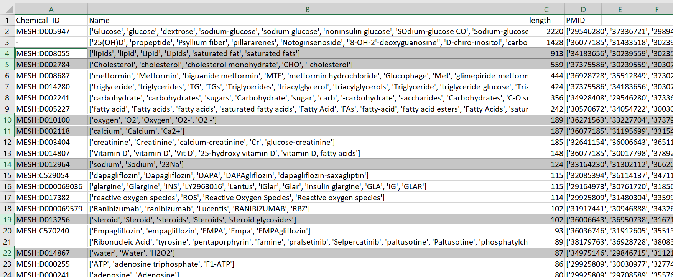
Remove atoms/elements and other non related chemicals based terms. Some of them are highlighted.

Slide 18
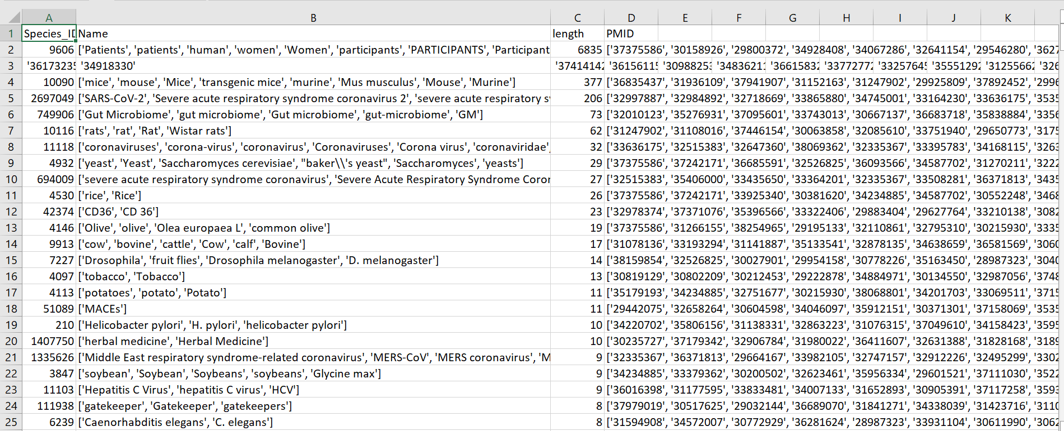
For virusDB: just keep the PMIDs which are related to your assigned virus, and remove other species terms. Proceed with other pubmedminer tasks with these papers only.

Slide 19
Interaction
To check the co-occurrence
For example “This drugA is inhibiting or activating this particular geneA”
SubmissionSheet: DiseaseShortFrom_Interaction_GrpNo.csv
Columns:
PMID | PMCID | Sentence | Genes | Chemicals | Interaction type | Regulation
 |  | Example | drugA | geneA | Inhibition | Up
 |  |  |  |  | Activation | Down
 |  |  |  |  | Proliferation | Upr egulated
 |  |  |  |  | Allosteric | Down regulated
 |  |  |  |  | Agonist
 |  |  |  |  | Antagonist

Slide 20
Interaction
To check the co-occurrence, For example,
“This drugA is inhibiting or activating this particular geneA”,
[SubmissionSheet: DiseaseShortFrom_Interaction_GeneToChemical_GrpNo.csv]
[SubmissionSheet: DiseaseShortFrom_Interaction_GeneToDisease_GrpNo.csv]

Slide 21
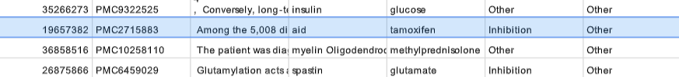
Example - Inhibition
Among the 5,008 disease-drug links, connections with negative scores suggest new indications for existing drugs, such as the use of some antimalaria drugs for Crohn's disease, and a variety of existing drugs for Huntington's disease; while the positive scoring connections can aid in drug side effect identification, such as tamoxifen's undesired carcinogenic property., These hypotheses are aligned with some published studies [44]–[49]. For example, tamoxifen inhibits mast cell secretion in a rat study, probably via PKC [47]. The mast cell's critical role in allergic reactions indicates that this is consistent with the negative connection between them in our results., Interestingly, we find that tamoxifen is “positively” (i.e. similar profile patterns with positive correlations and/or enrichment score) linked to many types of cancers and other disorders (namely, Endometriosis, Cystic fibrosis, HPV positive and early HIV infection) that share common underlying biological processes with cancer (such as cell invasion, uncontrolled growth, and weakened immunity etc.).

Slide 22
For protein sequences | references | VirusDB
Get the protein counts on the reference sequence (there is only one reference sequence for each protein), so that there are no duplicates.
Get the count for the total number of mutational/protein sequence available apart from ref seq for each protein
We will be doing mutational analysis on the same data, so make sure that you have all the sequences download in fasta format from uniprot and NCBI. A pipeline will be shared soon.
Start with mutational analysis as discussed.

Slide 23
Give sentences pmc
This function is limited to the papers which are having PMCID, so create a function to get the sentence from abstract for each term. File name will be in the same format, just add abstract_ in front of them.

Slide 24
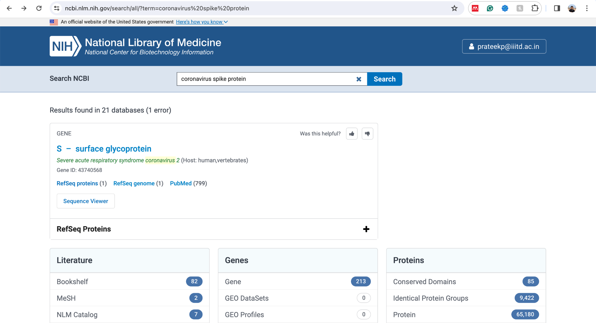

Slide 25
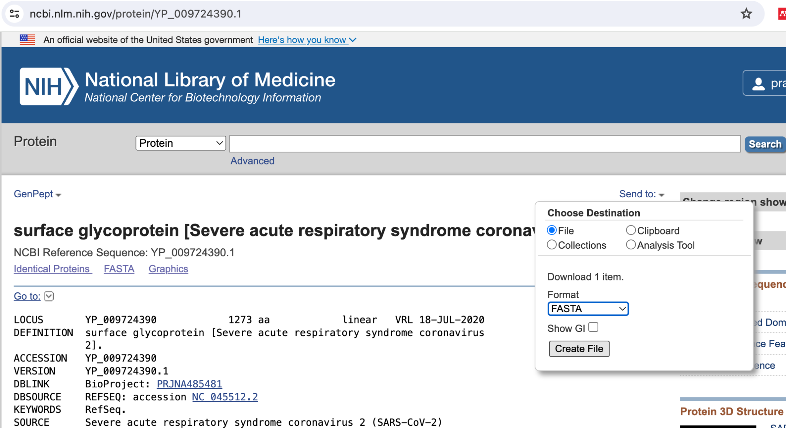

Slide 26
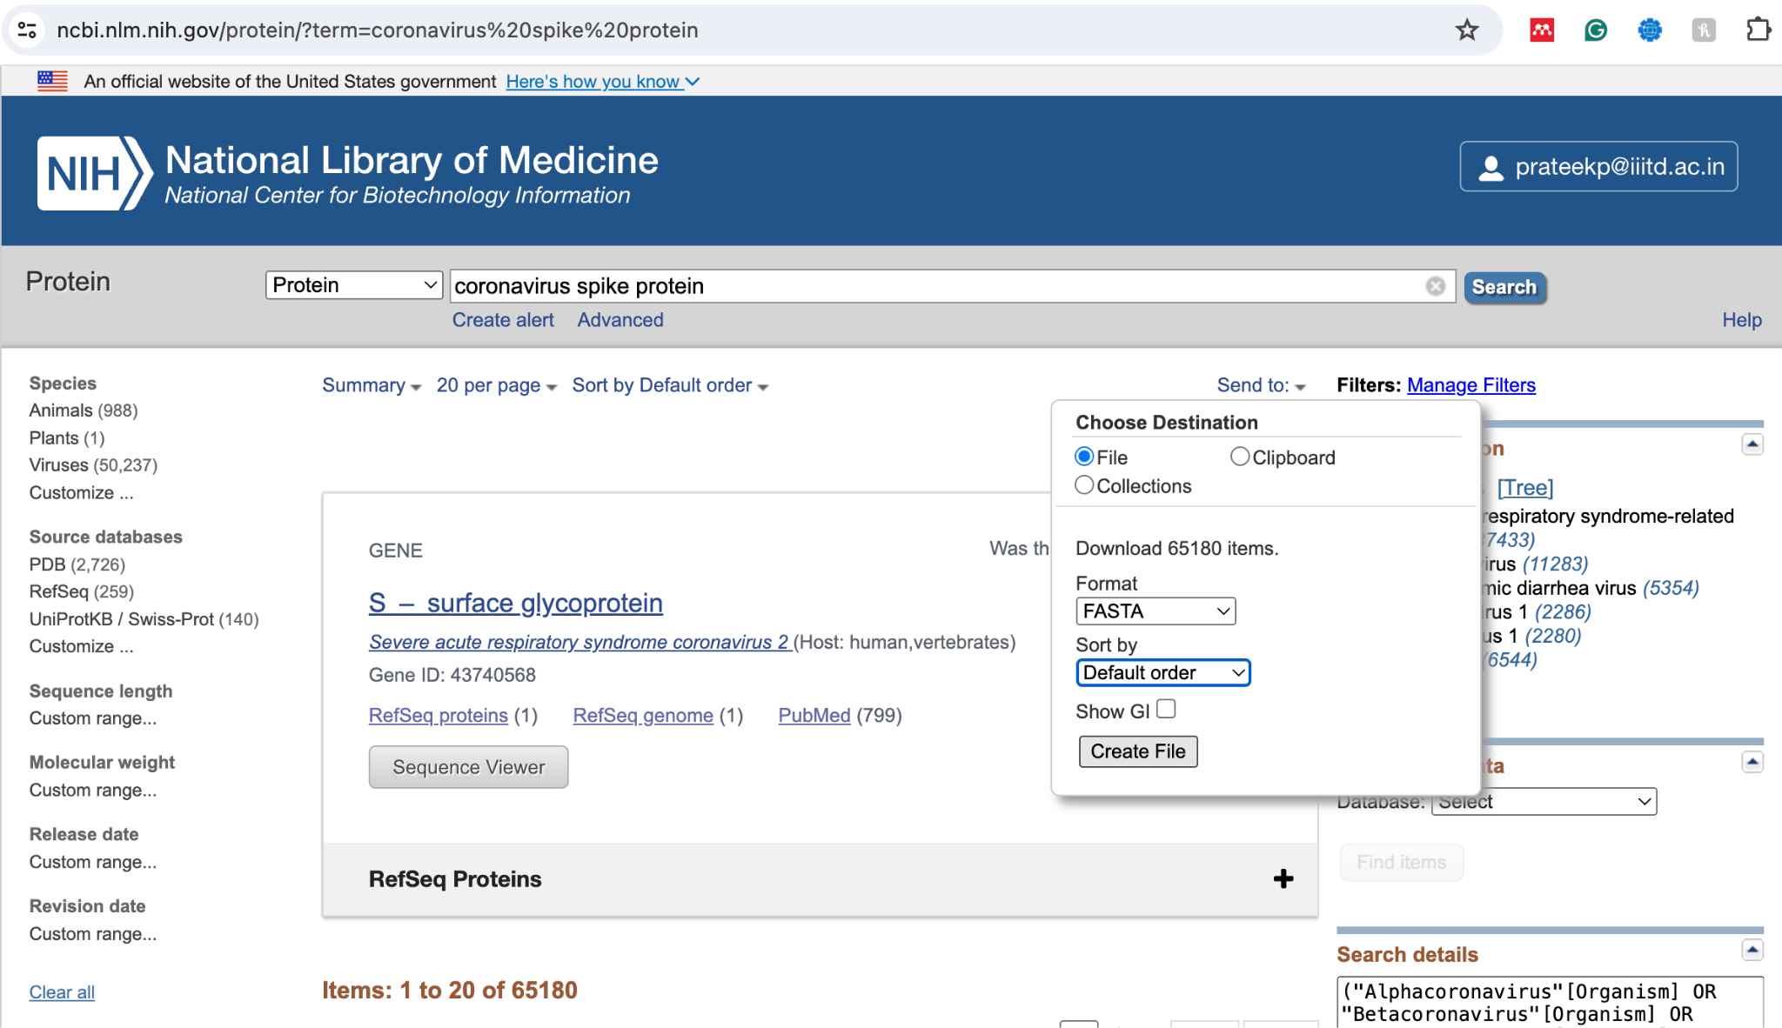

Slide 27
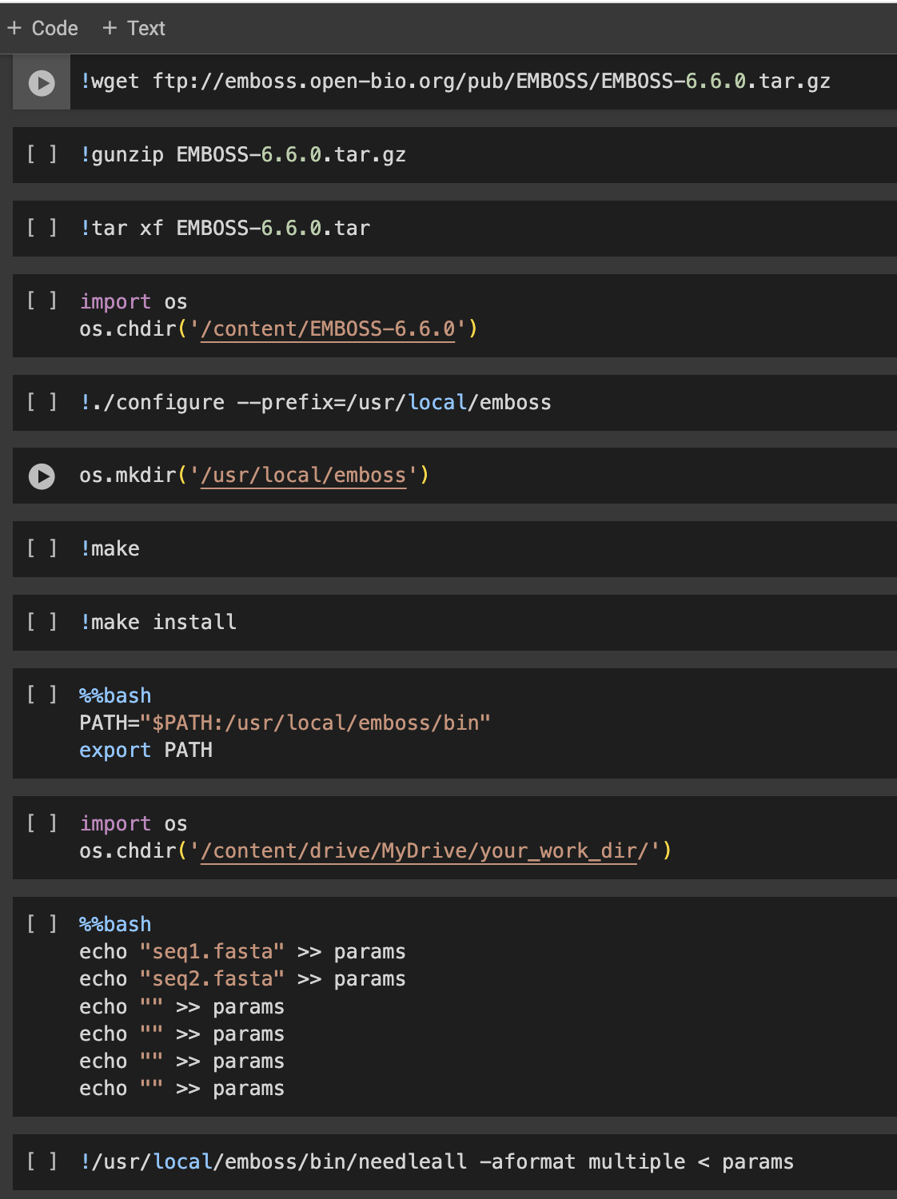
EMBOSS alignment
https://emboss.sourceforge.net/apps/release/6.6/emboss/apps/needleall.html
Proform the analysis for spike protein, will have to do this with all protein till the end.
Contact
rudrakshic@iiitd.ac.in for mutational analysis.
Notes:
https://emboss.sourceforge.net/apps/release/6.6/emboss/apps/needleall.html

